Slide 1
Petra Makovec, OM Gaia-X
January 2023

Slide 2
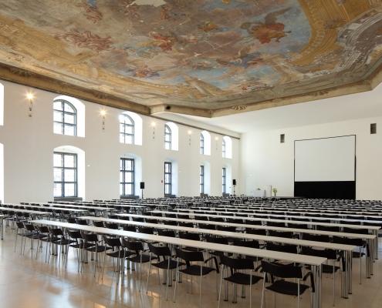
Gaia-X Market-X Conference & Expo Event
Gaia-X Event Market-X will welcome Lighthouse project initiatives, endorsed projects, hubs and verticals funded projects, technology providers, and more.
Join us to:
Find business matches
Showcase project demos
Join X-Industry projects
Discover technology solutions
Be part of Gaia-X market adoption community
Where: Vienna, Aula Der Wissenschaften
When: 14-15 March 2023

Slide 3
Market-X Conference & Expo
„connect people, ideas and solutions“
Networking Event of Gaia-X
Project Verticals
Gaia-X Hubs
Lighthouse Projects
X-industry projects
Solution Providers
SMEs
interested Companies, Initiatives and decision-makers meet to network and mingle
Market-X is the opportunity to collaborate, get assistance on building services & products, or to connect with technology companies, get in touch with publicly financed projects in order to begin utilising the Gaia-X Framework
A unique opportunity learn about Gaia-X value chains on several levels, from use cases adoption to data spaces
better understand industry approach and getting introduced to industry specific projects

Slide 4
Market-X Conference & Expo
connect people and ideas
networking event of Gaia-X Project Verticals, Gaia-X Hubs and Gaia-X Lighthouse Projects, X-industry projects Providers, SMEs, interested Companies, Initiatives and decission-makers meet to network and mingle.
an opportunity to collaborate, get assistance on building services & products, or to connect with technology companies, get in touch with publicly financed projects in order to begin utilising the Gaia-X Framework.
a special chance to learn about Gaia-X value chains on several levels, from use cases adoption to data spaces
better understand industry approach and getting introduced to industry specific projects

Slide 5
Market-X Expo
We offer 4 different packages for the Expo Area!
The "Platinum" package: for the cost of fifteen thousand (15,000) EUR.
The "Gold" package: for the cost of eight thousand (8,000) EUR.
The "Silver" package: for the cost of three thousand five hundred (3,500) EUR.
The "Bronze" package: for the cost of two thousand (2,000) EUR.
Why to attend:
You want to advertise your project, HUB, vertical
You want to find partners for your project, or you are looking for a consortia partner.
You want more visibility for your Project or Product
You want to connect with technology providers or consulting companies to get Gaia-X into use.
You want to present your company to a broad audience that supports the Gaia-X Vision

Slide 6
Market-X links
Event Website: https://gaia-x.eu/event/market-x/
Registration: https://gaia-x.flave.world/registration_pages/gaiaEN
Expo Partner Agreement: https://gaia-x.eu/wp-content/uploads/2023/01/Market-X_Expo_Partner_Agreement.pdf

Slide 7
Thank you

